Slide 1
Universal Synchronous and Asynchronous Receiver and Transmitter - USART
Dr.Sreejith Rajan

Slide 2
USART
USART is a serial communication module built into the ATmega328 microcontroller.
It allows the MCU to communicate serially - that is, send and receive data one bit at a time through two wires:
  TX (Transmit) — sends data out from the MCU
  RX (Receive) — receives data into the MCU

Slide 3
USART - Modes
Asynchronous Mode - no external clock (most common, e.g. RS-232 communication with PC)
Synchronous Mode - uses an external clock for data timing (rarely used)
No synchronous ➔ USART ➔ UART

Slide 4
Baud Rate
  It’s the speed of data transmission between two devices.
For example:
9600 baud → 9600 bits per second
115200 baud → 115,200 bits per second
1

Slide 5
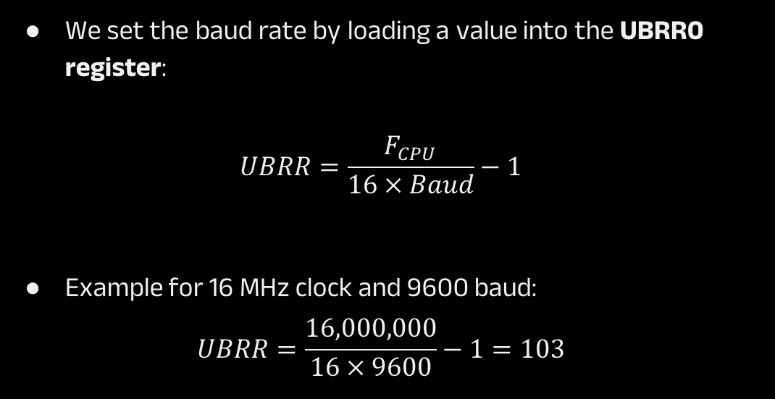
Baud Rate
We set the baud rate by loading a value into the UBRR0 register:
$$UBRR=\frac{F_{CPU}}{16×Baud}−1$$
Example for 16 MHz clock and 9600 baud:
$$UBRR=\frac{16,000,000}{16×9600}−1=103$$

Slide 6
Useful Registers
Register | Full Name | Function / Purpose
UBRR0H | USART Baud Rate Register High | Holds the upper 8 bits of the 16-bit baud rate value
UBRR0L | USART Baud Rate Register Low | Holds the lower 8 bits of the baud rate value
UCSR0A | USART Control and Status Register A | Contains status flags and control bits (TX complete, RX complete, buffer empty, double speed, etc.)
UCSR0B | USART Control and Status Register B | Used to enable/disable transmitter, receiver, and interrupts; selects 9-bit mode
UCSR0C | USART Control and Status Register C | Sets frame format (data bits, stop bits, parity mode, sync/async mode)
UDR0 | USART Data Register | Actual data buffer used for both transmit and receive operations
1

Slide 7
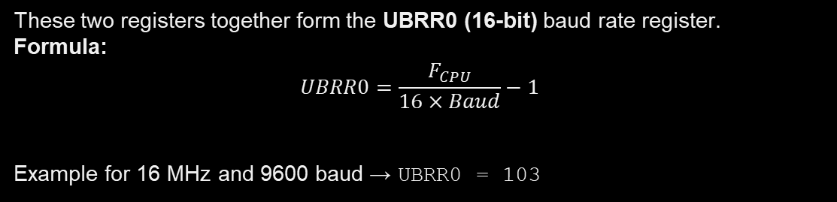
UBRR0H & UBRR0L – Baud Rate Registers
These two registers together form the UBRR0 (16-bit) baud rate register.
Formula:
$$UBRR0=\frac{F_{CPU}}{16×Baud}−1$$
Example for 16 MHz and 9600 baud → UBRR0 = 103
1
So we can use
UBRR0H = 0;
UBRR0L = 103;

Slide 8
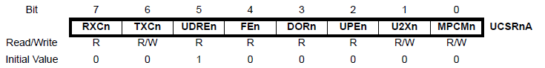
UCSR0A – Control and Status Register A
Bit | Name | Description
7 | RXC0 | Receive Complete flag (1 → data received)
6 | TXC0 | Transmit Complete flag (1 → transmission done)
5 | UDRE0 | USART Data Register Empty (ready for new byte)
4 | FE0 | Frame Error (stop bit missing or corrupted)
3 | DOR0 | Data OverRun (new data arrived before previous read)
2 | UPE0 | Parity Error
1 | U2X0 | Double the transmission speed
0 | MPCM0 | Multi-processor mode enable
1

Slide 9
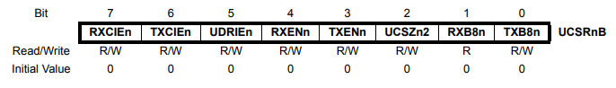
UCSR0B – Control and Status Register B
Bit | Name | Description
7 | RXCIE0 | RX Complete Interrupt Enable
6 | TXCIE0 | TX Complete Interrupt Enable
5 | UDRIE0 | Data Register Empty Interrupt Enable
4 | RXEN0 | Receiver Enable
3 | TXEN0 | Transmitter Enable
2 | UCSZ02 | Character Size bit (used with UCSZ01:0 for 9-bit mode)
1 | RXB80 | Received data bit 8 (9-bit mode)
0 | TXB80 | Transmit data bit 8 (9-bit mode)
1

Slide 10
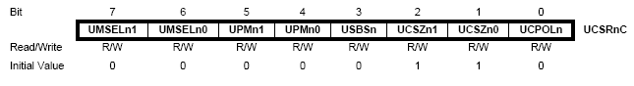
UCSR0C – Control and Status Register C
Bits | Name | Description
7:6 | UMSEL01:0 | Mode select (00 = Asynchronous, 01 = Synchronous, 10 = SPI Master)
5:4 | UPM01:0 | Parity mode (00 = None, 10 = Even, 11 = Odd)
3 | USBS0 | Stop bit select (0 = 1 stop bit, 1 = 2 stop bits)
2:1 | UCSZ01:0 | Character size bits (11 = 8-bit data)
0 | UCPOL0 | Clock polarity (used only in synchronous mode)

Slide 11
UDR0 – The data register
It’s an 8-bit register where data is saved before sending or after reception

Slide 12
THANK YOU

